Slide 1
Linear Regression

Slide 2
CONTENTS
Introduction to Linear Regression | What is Linear Regression, examples, kinds of LR
Loss function | basic mathematical background of LR
Lab
For more info: SLIDESGO | SLIDESGO SCHOOL | FAQs
You can visit our sister projects: FREEPIK | FLATICON | STORYSET | WEPIK | VIDEVO

Slide 3
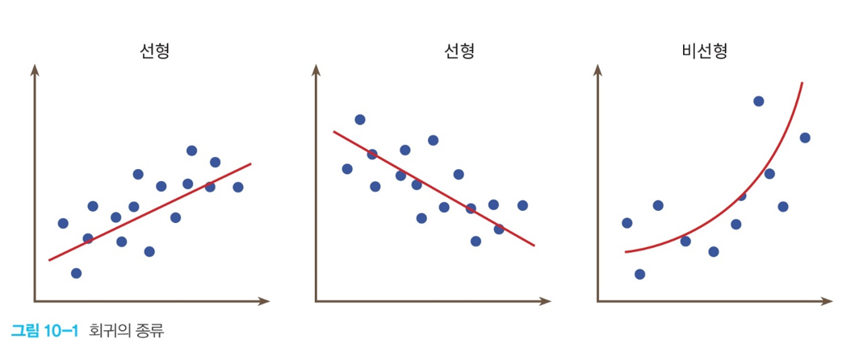
Introduction to Linear Regression
What is Linear Regression?
Regression is finding a linear or a curve which represent the tendency of data.
Therefore, Linear Regression(LR) is finding a linear which represents the tendency of data.
 | sleep hours | score
A | 7 | 84
B | 6 | 80
C | 8 | 82
…………

Slide 4
Introduction to Linear Regression
Examples where Linear Regression can be used:
relationship between height and weight.
relationship among age, sex, bmi, and diabetes.
relationship among building class, street, type of alley access, and house prices.

Slide 5
Introduction to Linear Regression
Kinds of Linear Regression; simple Linear Regression and multiple Linear Regression
1. simple Linear Regression: 1 variable, w is weight and b is bias
f(x)=wx + b
2. multiple Linear Regression: more than 1 variable, wn is weight and b is bias
f(x0, x1, x2, …) = w0x0 + w1x1 + w2x2 + … + b

Slide 6
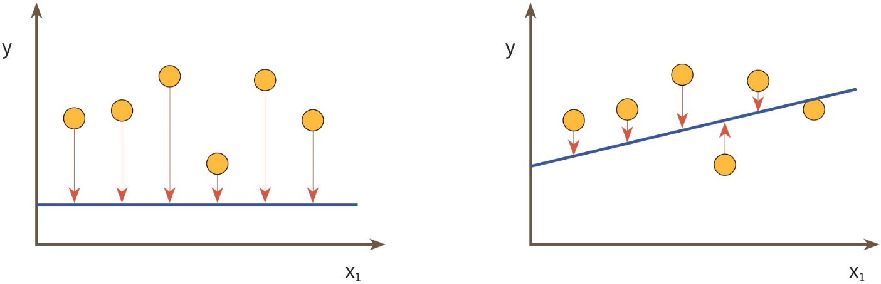
Loss function
To find an appropriate linear, we need to minimize gaps between the linear and each data.

Slide 7



Loss function
We can calculate the gaps like this: But they can be negative….
$$f\left(x_{i}\right)−y_{i}$$
x | y
0 | 2 | -2
-1 | 3 | -4
-2 | 4 | -6
-3 | 5 | -8
$$f\left(x_{i}\right)−y_{i}$$
$$f\left(x_{i}\right)−y_{i}$$
x | y
-100 | 2 | -102
-101 | 3 | -104
-102 | 4 | -106
-103 | 5 | -108

Slide 8
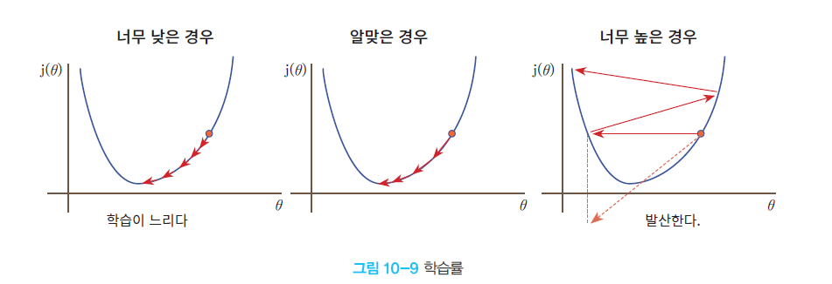


Loss function
Therefore, we square it
$$Loss function E\left(W, b\right)=\frac{\sum_{i=1}^{n}{{\left(f\left(x_{i}\right)−y_{i}\right)}^{2}}}{n}=\frac{\sum_{i=1}^{n}{{\left(Wx_{i}+b−y_{i}\right)}^{2}}}{n}$$
$$W=W−\frac{∂E\left(W,b\right)}{∂W}$$
$$b=b−\frac{∂E\left(W,b\right)}{∂b}$$
This is called "gradient descent method"

Slide 9
Lab
Relationship between sleep hours, study hours, and score.
sleep hours | study hours | score
8 | 3 | 56
7 | 7 | 78
4 | 13 | 92
8 | 7 | 98
10 | 5 | 66
9 | 10 | 97

Slide 10
Lab-your own dataset
Make your own dataset and a Linear Regression model

Slide 11
Lab
1.Make train data and test data using numpy.random.rand()
2.Draw a scatter
3.Make a Linear Regression model
4.Print score of the Linear Regression about the train data

Slide 12
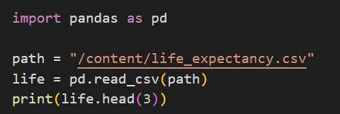
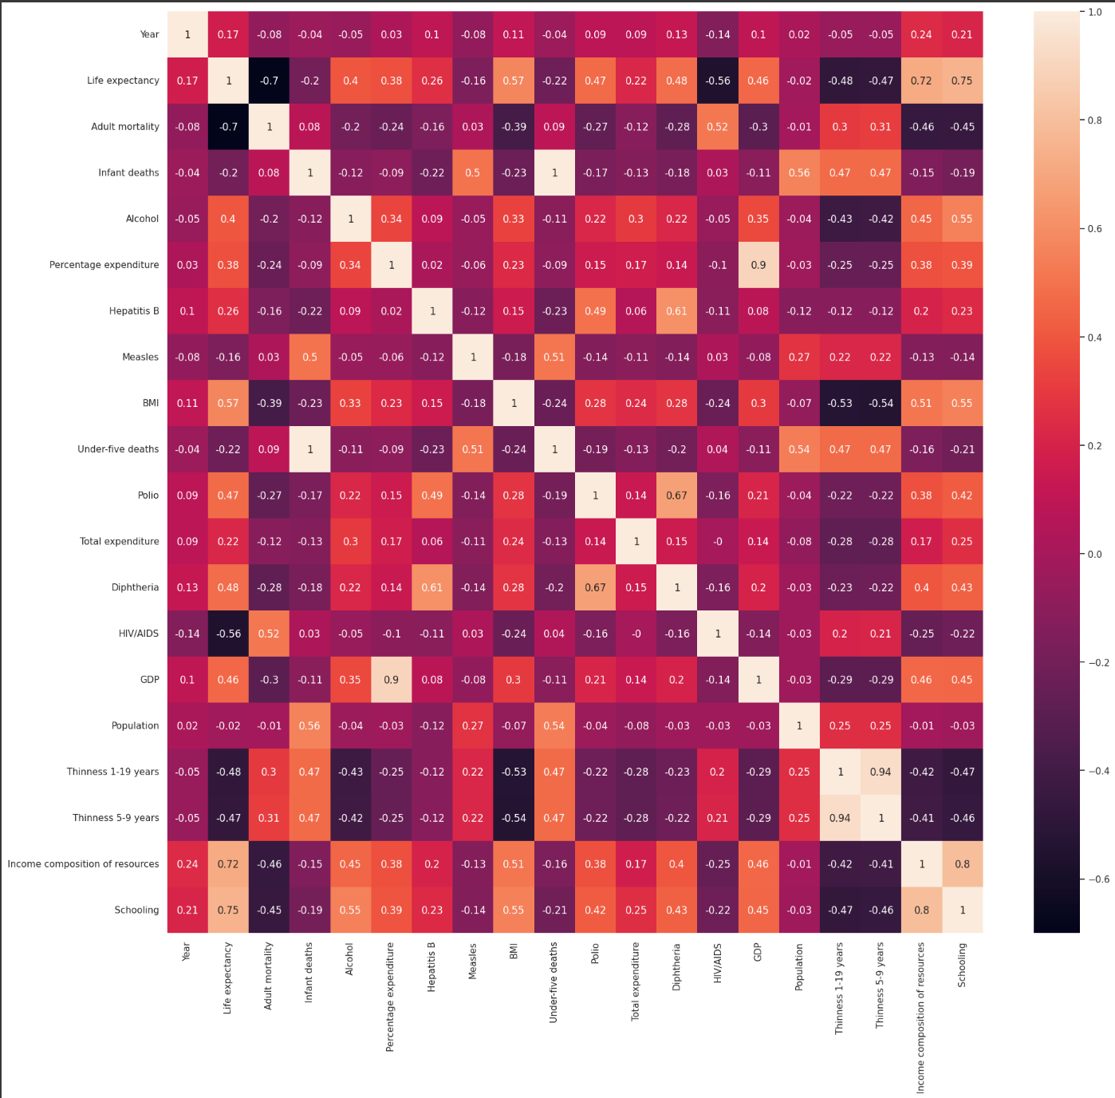
Lab-life expentancy using LR
1.load csv file (cf. path can be different)
2.get correlation between life expectancy and each data. And Draw a heatmap like below.

Slide 13
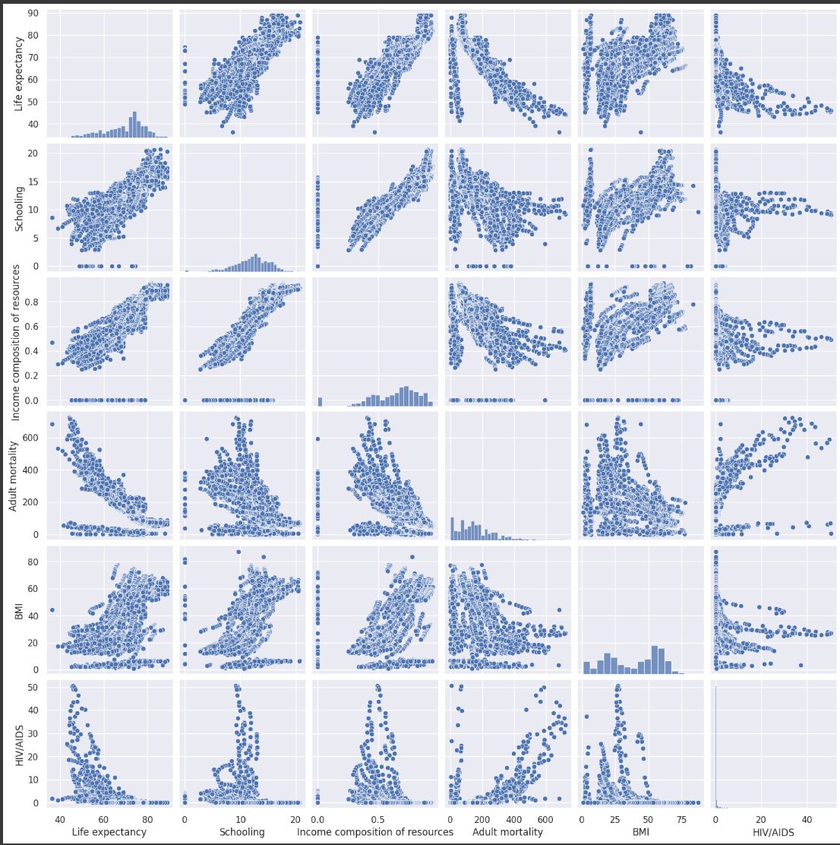
Lab-life expentancy using LR
3.print corr data in order of ascending. ( the form of ouput is: feature_name corr )
4.print 5 high-corr data ( the form of ouput is: feature_name corr )
5.Draw pairplots using seaborn of the 5 high-corr data like below.

Slide 14

Lab-life expentancy using LR
6.check sum of null data and drop them.
7.make a Linear Regression using the 5 high-corr data as inputs. And Print score about test data.

Slide 15
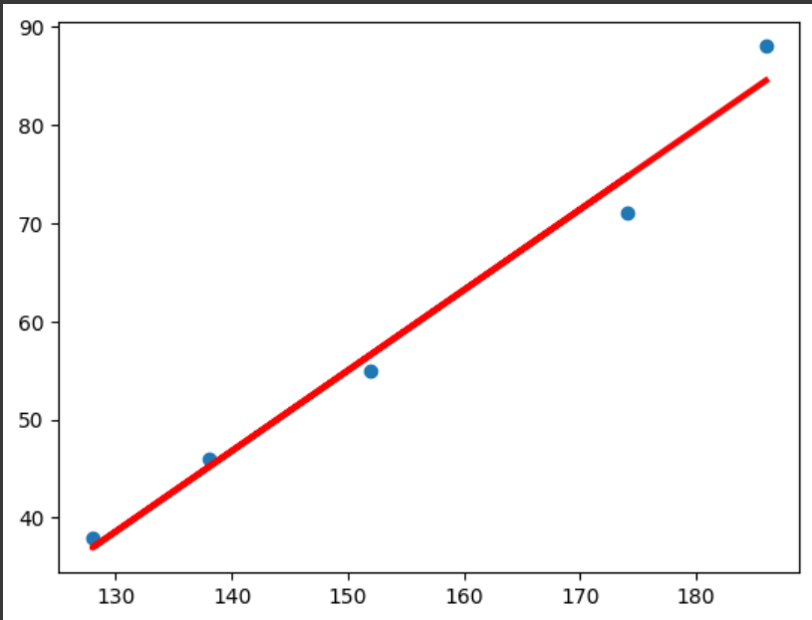
Lab-Relationship between height and weight
make datasets based on this table.
plot scatter height vs. weight
Do Linear Regression
print weight W and bias b
plot scatter and predicted line, height vs. weight
Height (cm) | Weight (kg)
174 | 71
152 | 55
138 | 46
128 | 38
186 | 88

Slide 16
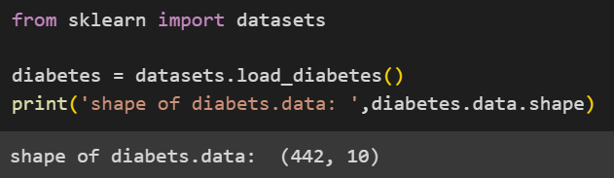
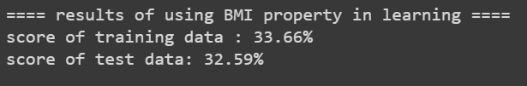
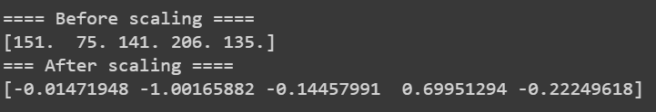
Lab-Diabetes prediction using LR
0.load diabetes dataset from sklearn.
1. seperate this data into 70% traning data and 30% test data.
2. make a Linear Regression model that predicts diabetes using BMI info.
3. Get prediction scores of the Linear Regression of problem (2). Also, get score of the Linear Regression about the test data.
4. diabetes values are integers from 25 to 346. Print these values as floats between -1 and 1 by scaling using StandardScaler.

Slide 17
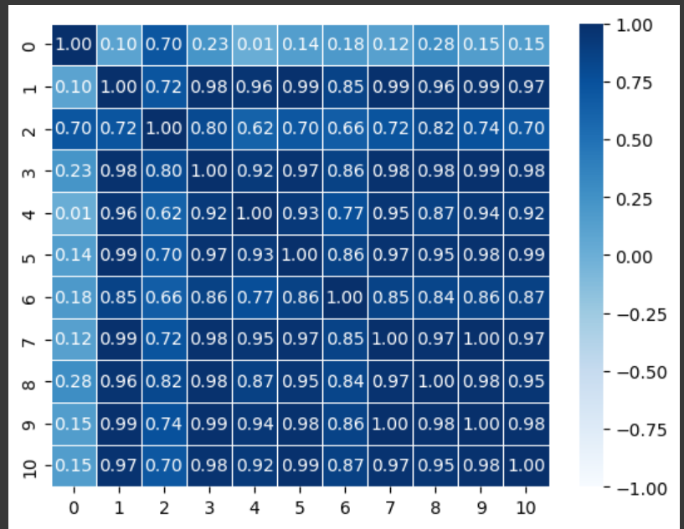
Lab-Diabetes prediction using LR
5. Get relationship between diabetes and each property and Draw it as a form of heatmap below.

Slide 18
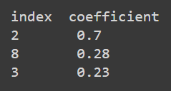


Lab-Diabetes prediction using LR
6. Based on the above, print indexes and coefficients of 3 high-corr properties.
7. Make a Linear Regression model which uses the 3 properties as inputs and do the same work with problem (3).
8. make a Linear Regression model which uses all properties as inputs and do the same work with problem (3).

Slide 19
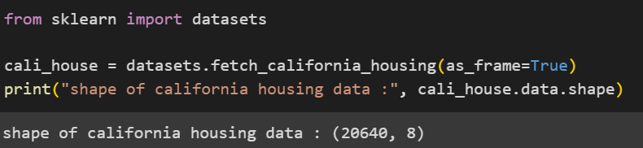
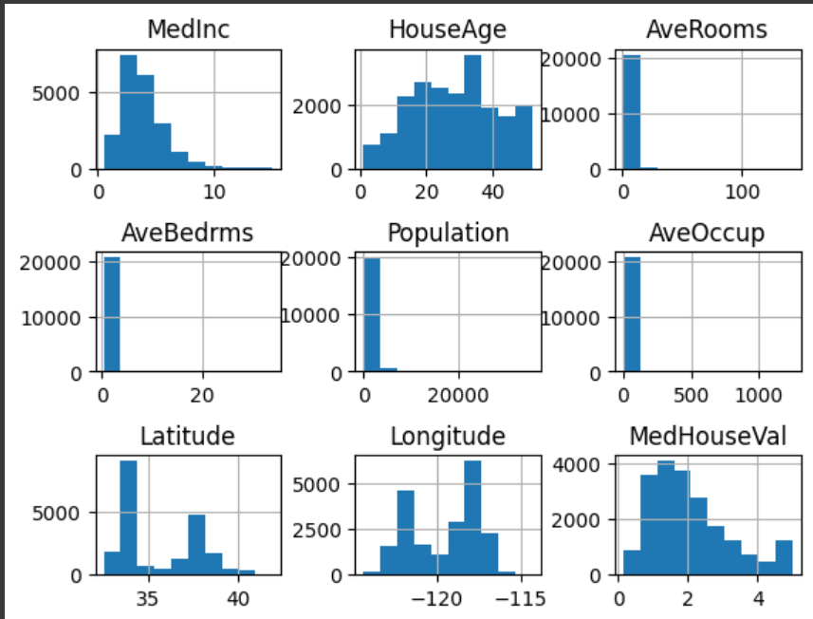
Lab-California Housing dataset
0.load california housing dataset
1.look at the distribution of features by plotting their histograms Hint: use cali_house.frame.hist() and plt.subplots_adjust(hspace=0.7, wspace=0.4)

Slide 20
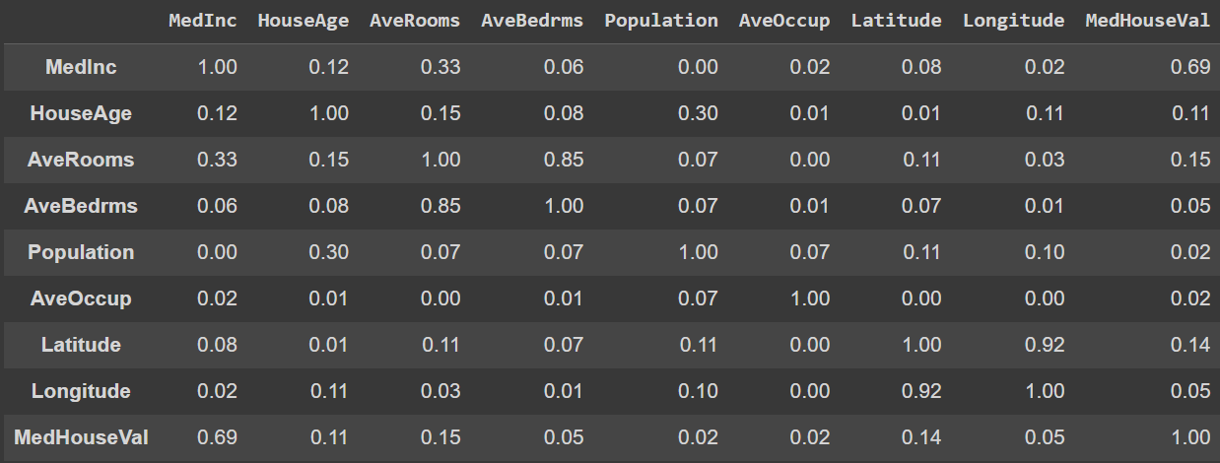
Lab-California Housing dataset
2.get correlation between the features and print them as a DataFrame. Round them to two decimal places and convert each number into absolute numbers. Hint: use cali_house.frame

Slide 21
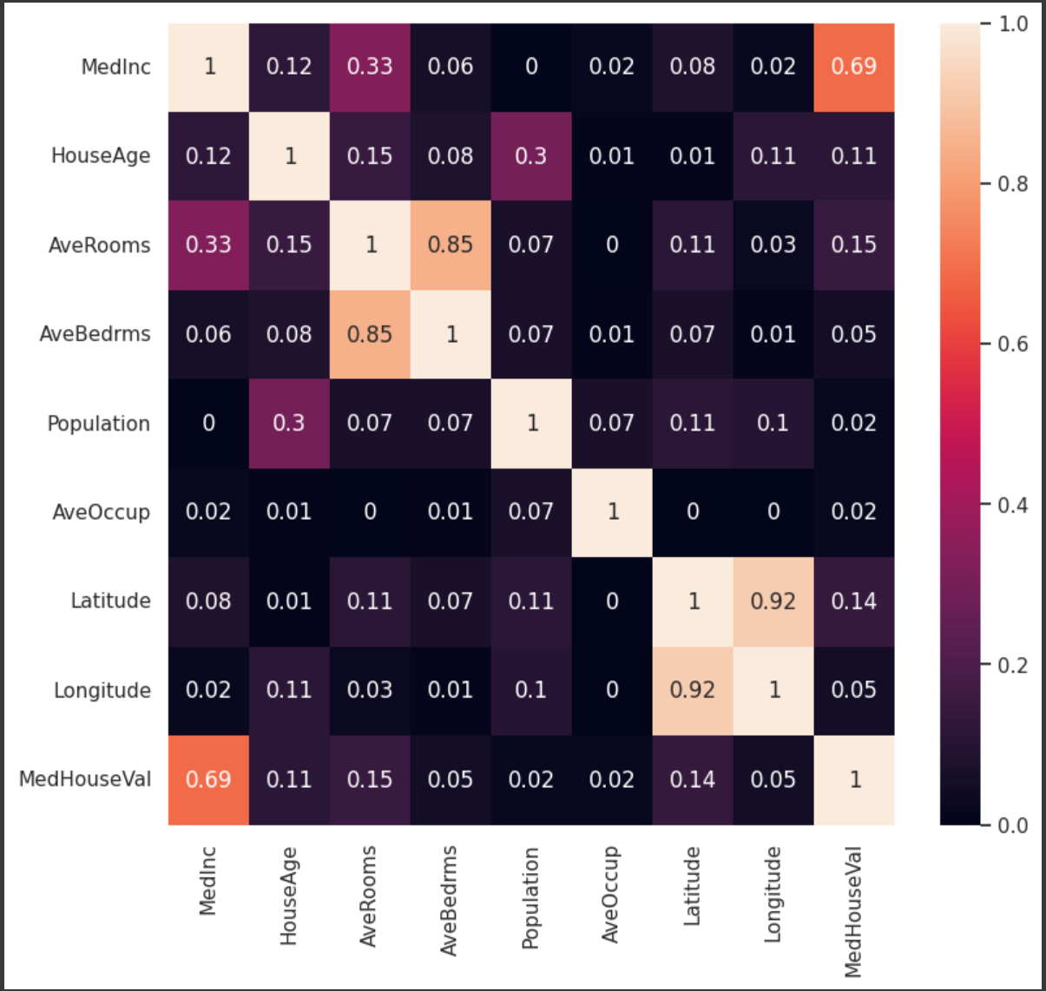
Lab-California Housing dataset
3.Draw a heatmap of the correlation DataFrame. Hint: add sns.set(rc={'figure.figsize':(9,8)})before writing sns.heatmap().

Slide 22
Lab-California Housing dataset
4.Make a Linear Regression model. 4-1.separate cali_house.data and cali_house.target into 60% training data and 40% test data with shuffling. 4-2.make a Linear Regression model and train it. 4-3.predict test data. 4-4.get model scores about both training data and test data.
5.Do Scaling using sklearn.preprocessing.StandardScaler()
6.Make a Linear Regression model after scaling.
7.Print model scores after scaling and compare it with the previous model.

Slide 23
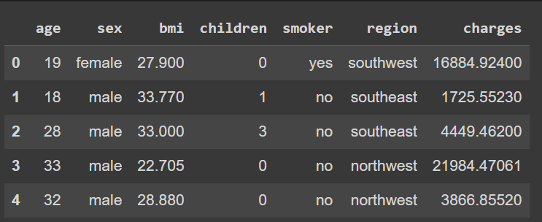
Lab-medical cost personal datasets
0.Get "medical cost personal datasets" from here: https://www.kaggle.com/datasets/mirichoi0218/insurance
1.load the insurance.csv file.
2.check the DataFrame by using head() method.

Slide 24
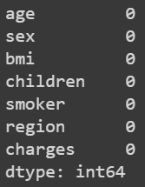
Lab-medical cost personal datasets
3.check null data in the DataFrame.

Slide 25
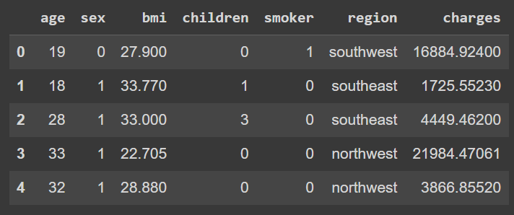
Lab-medical cost personal datasets
4.preprocessing 3-1.change the values in sex column. If sex is female, then the value is 0. And if sex is male, then the value is 1. 3-2.change the values in smoker column. If smoker is yes, then the value is 1. And if smoker is no, then the value is 0. 3-3.check the revised DataFrame.

Slide 26
Lab-medical cost personal datasets
5.visualize relationship with scatter, line, heatmap …
6.Make a Linear Regression model and get scores about training data and test data.

Slide 27
THANKS
Do you have any questions?
hong_hyeokjae@gm.gist.ac.kr

